Slide 1
Home Credit Default Risk Kaggle Project: Analysis
Mike Sun
孙穆
Information adapted from Will Koehrson

Slide 2

项目概况
Kaggle 是一个举办机器学习比赛的网站
The Home Credit Group is hosting this competition to find more accurate models for predicting risk of credit default.
Their goal is to allow worthy customers who lack credit histories to be evaluated and be able to obtain a loan

Slide 3
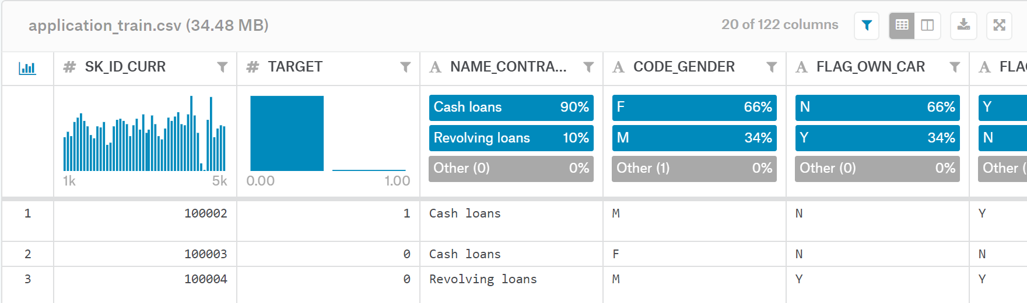
了解数据
一共十个数据集
主要是application_train.csv(训练集)和application_test.csv(测试集)
每一行代表一个贷款 （SK_ID_CURR）
训练集有多一行：TARGET （目标）
0: 偿还贷款了 1：没有偿还贷款

Slide 4
Evaluation Metrics
ROC AUC – Receiver Operating Characteristic Area Under the Curve
Graphs true positive rate vs the false positive rate
Integral of the ROC directly proportional with quality of the model
Measured as a probability, not as binary
Accuracy – correctly identified vs total
Sensitivity – true positive rate (% true positives identified correctly)
Specificity – true negative rate (% true negatives identified correctly)

Slide 5
Relevant Tools
Numpy – support for managing large data sets represented as matrices
Pandas – data manipulation and analysis
Scikit-learn – simple tools for data analysis (regression, clustering algorithms, etc)
Matplotlib – plotting and graphical representation
Seaborn – expands graphical tools in matplotlib

Slide 6
Exploratory Data Analysis
Target Distribution
Missing Values
Column Types
Dealing with Categorical Values
Dealing with Anomalies

Slide 7

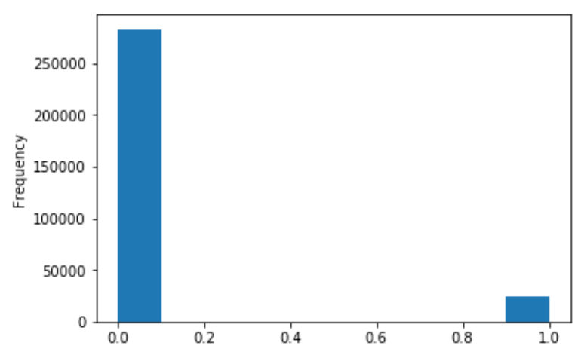
Target Distribution
Recall 0: repaid, 1: defaulted
Note this is an “imbalanced class problem”
In more complicated machine learning models, we can “weight the classes by their representation in the data to reflect this imbalance”

Slide 8
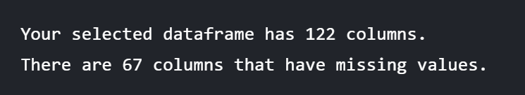
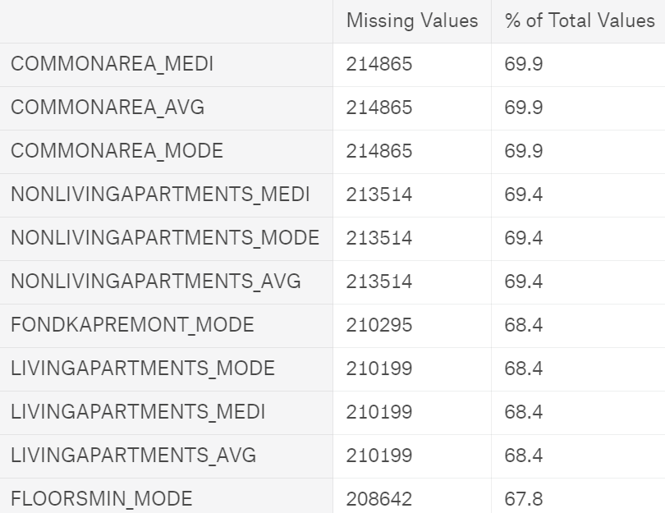
Missing Values
We should fill in missing values to accommodate our ML model, know as imputation.
There are models such as XGBoost, however, that can handle missing values.

Slide 9
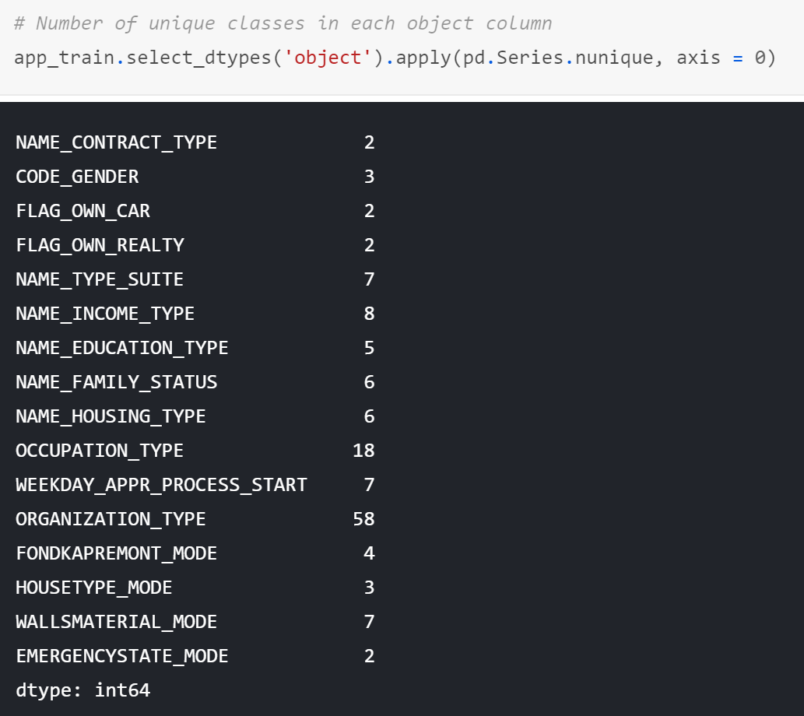
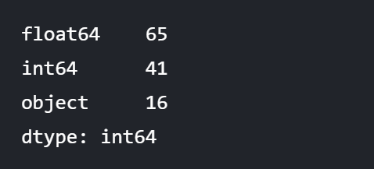
Column Types

Slide 10
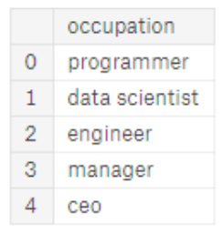
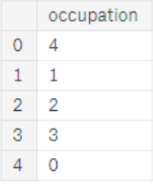
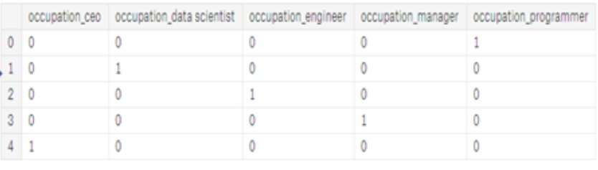
Encoding Categorical Values
Machine learning models cannot directly work with categorical values, as categorical values are not numbers.
Label encoding – simpler but assigns arbitrary ordering
One-hot encoding – solves the arbitrary ordering but creates many new columns
Original
Label Encoding
One-hot Encoding

Slide 11
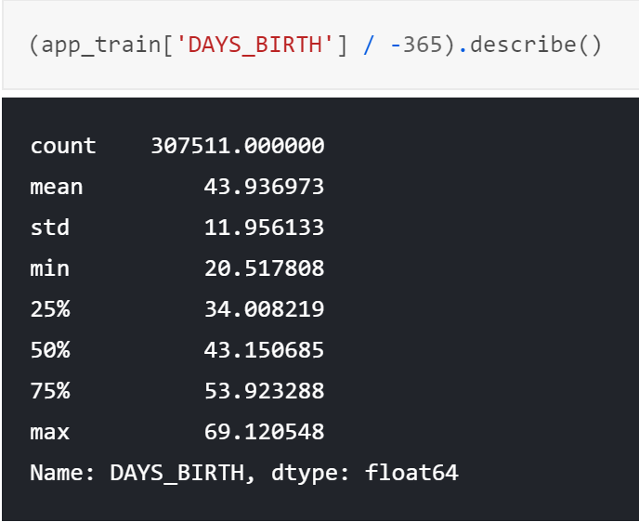
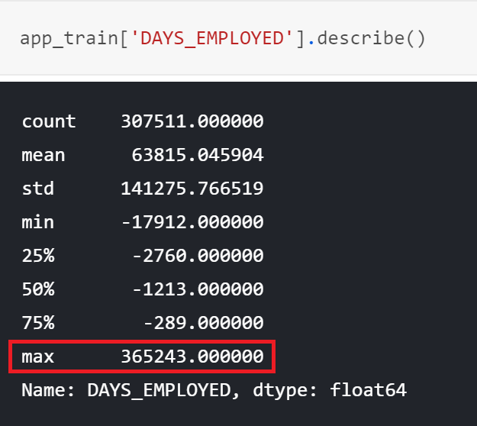
Anomalies

Slide 12
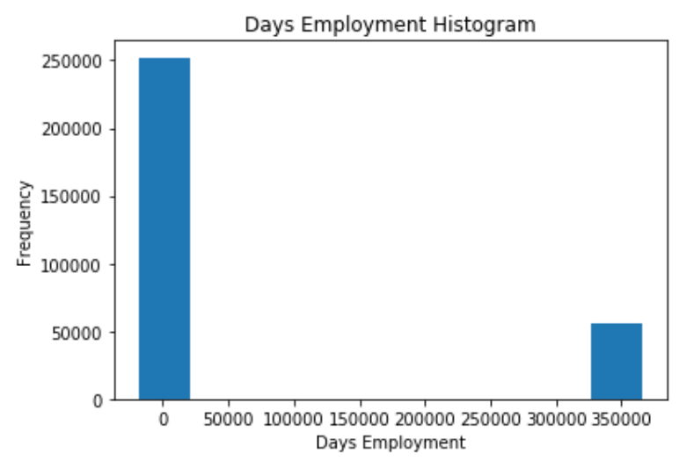
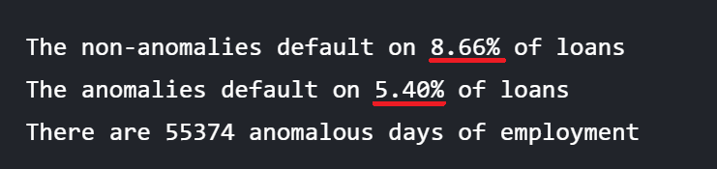
Example Anomaly – Days Employed

Slide 13
Correlations
Pearson correlation coefficient
.00-.19 “very weak”
.20-.39 “weak”
.40-.59 “moderate”
.60-.79 “strong”
.80-1.0 “very strong”

Slide 14
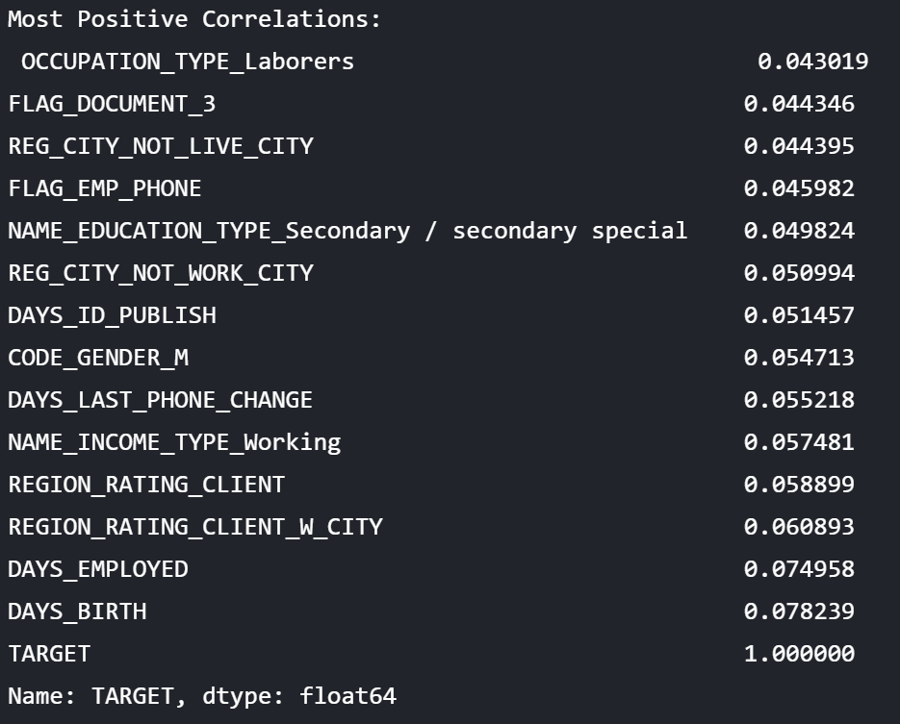
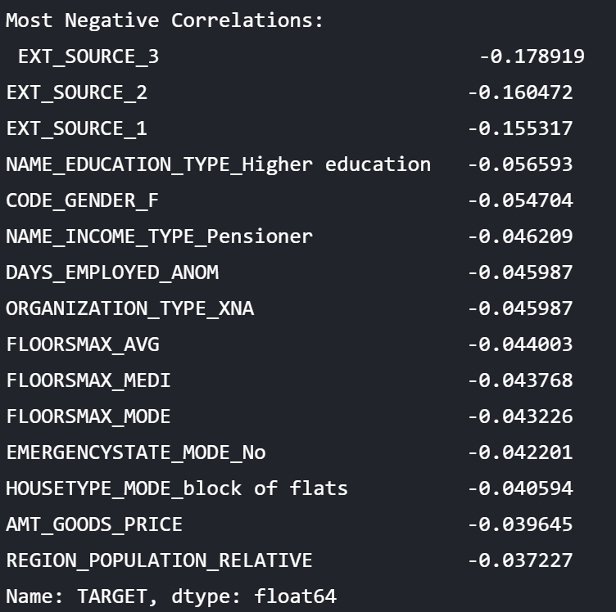
Correlations from Data

Slide 15
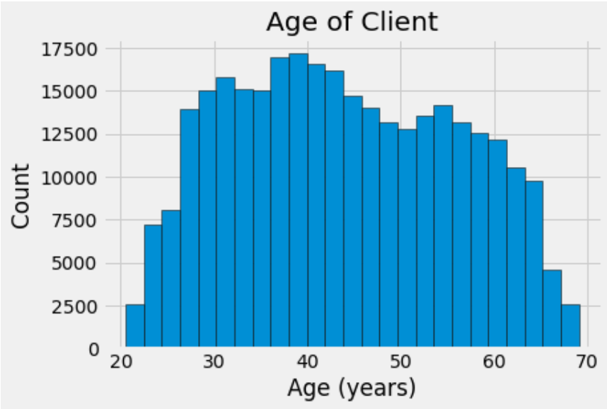
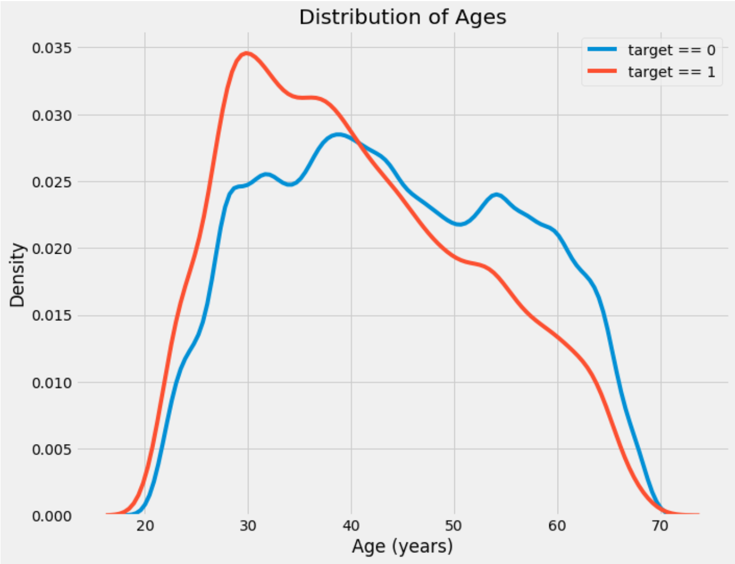
Example Correlation – Repayment vs Age
In the data, age is actually expressed as the negative age in days. Thus, the proper correlation of [Positive Age vs Repayment] would be -0.07823930830982694.
This means that age has a negative linear relationship with likelihood of repayment. The older an individual, the more likely they will repay the loan.
KDE (kernel density estimation plot)

Slide 16
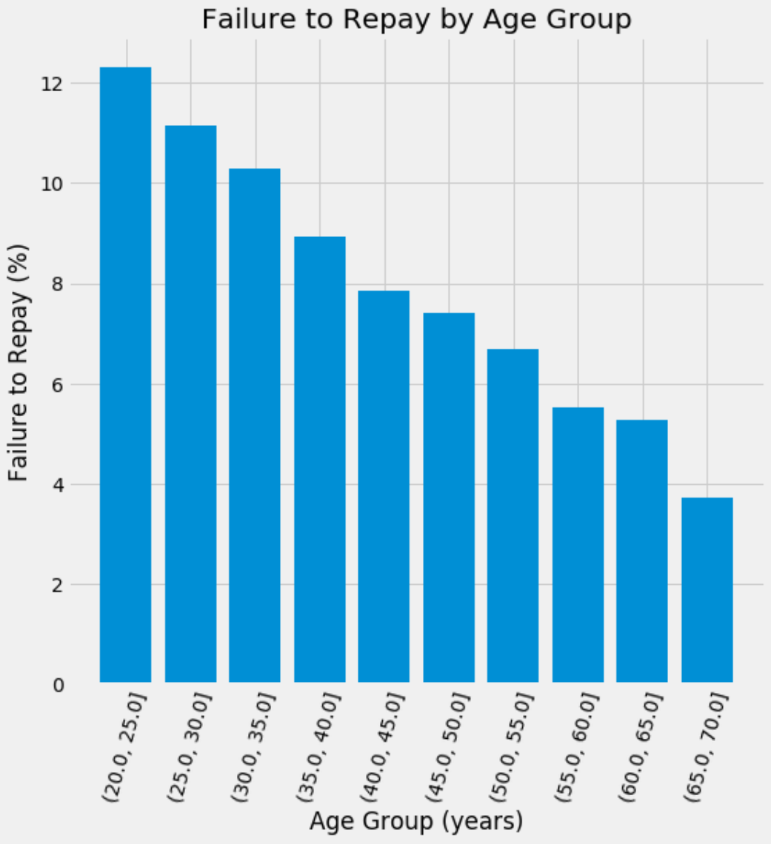
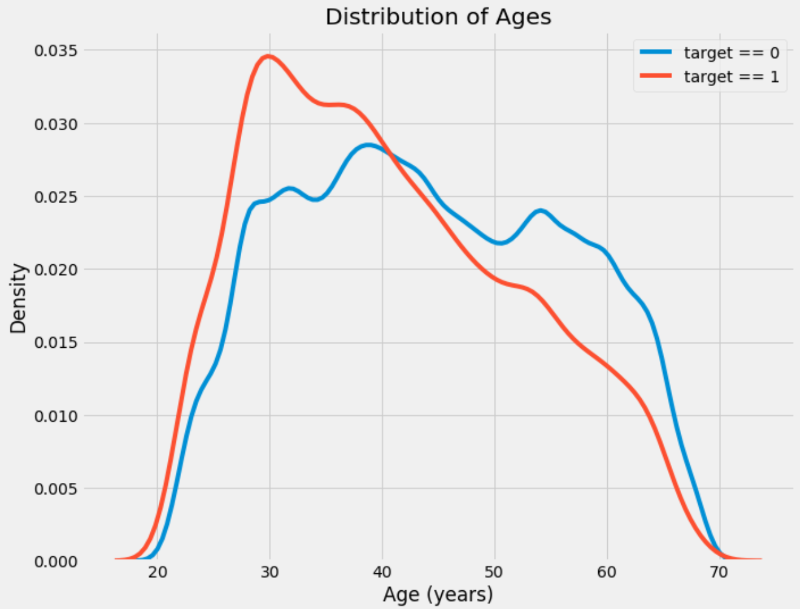
Average Failure to Repay Loans by Age

Slide 17
External Sources
There are columns labeled only as EXT_SOURCE_[1,2,3]
They had the greatest negative correlation with the Target data
We know nothing about how these figures were obtained, but can still check their correlation with and predict their effect on the target

Slide 18
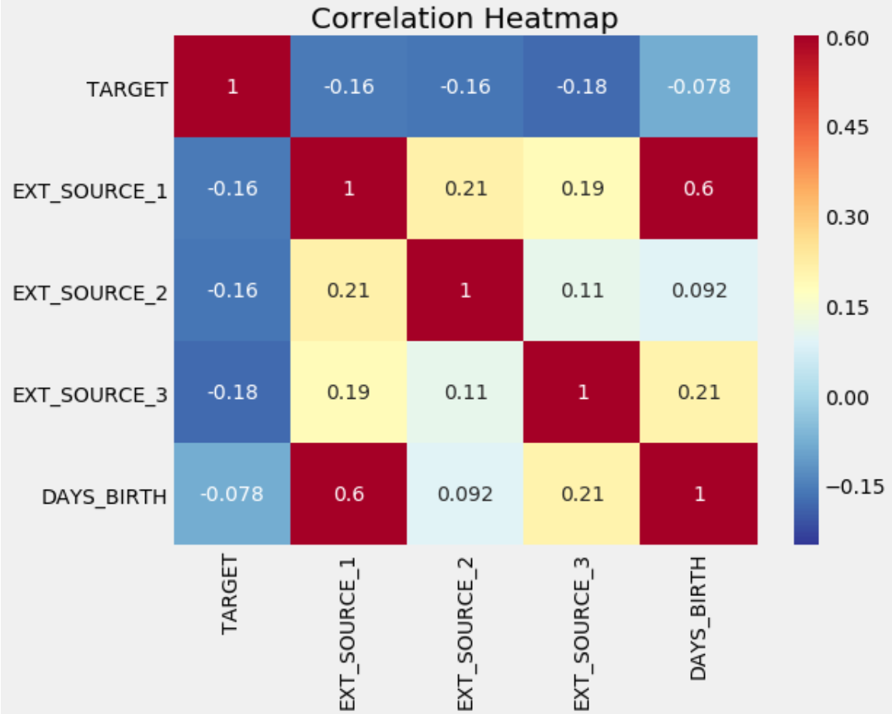
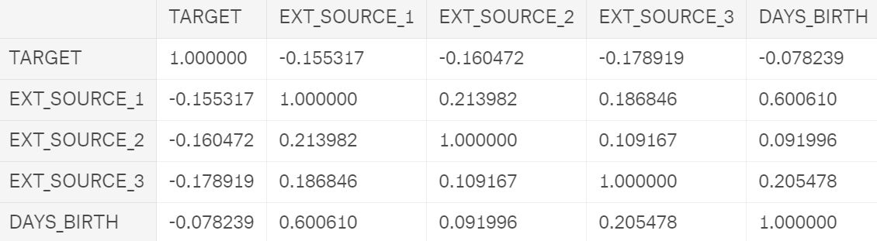
Co-correlation Matrix

Slide 19
Co-correlation Matrix
Shows the correlation of each feature with each other feature
Any feature will have a correlation of 1 with itself
Correlation with TARGET is the most important aspect here

Slide 20
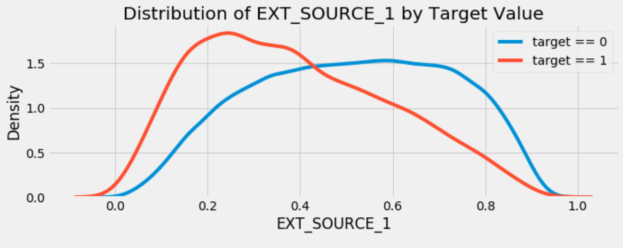
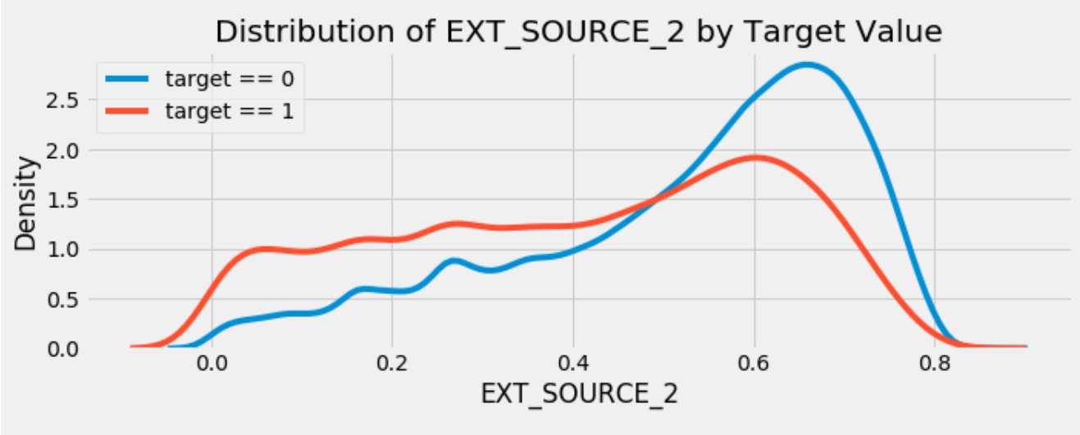
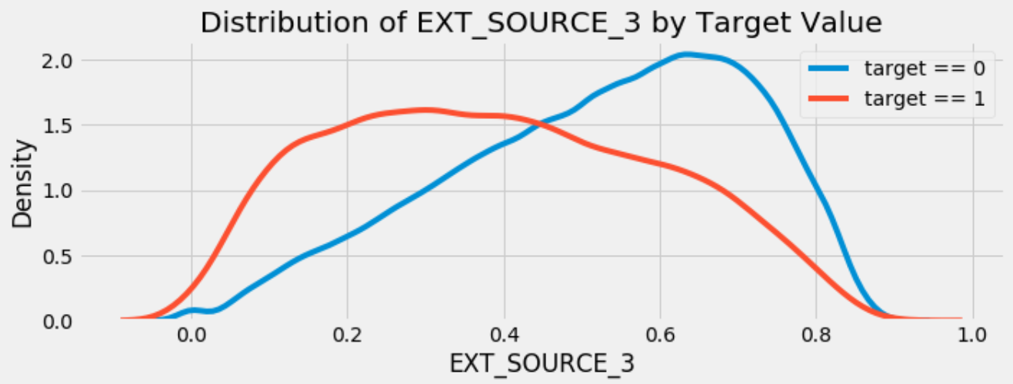
Distribution vs Target of EXT_SOURCE_[1,2,3]

Slide 21
Pairs Plots
[Learn and add slides]
https://towardsdatascience.com/visualizing-data-with-pair-plots-in-python-f228cf529166

